Slide 1


IPA FRAMEWORK

Slide 2

TABLE OF CONTENTS
EU-TR Partnership
Negotiating Framework
EU-TR Financial Cooperation
Methods of EU Budget Implementation
Instrument for Pre-accession (IPA)
Instrument for Pre-accession (IPA II) Allocations Per Country According toMulti-annual Financial Framework 2014–2020
IPA II Legal Background
The Indicative Strategy Paper for Turkey
The Commission’s Annual Progress Reports
IPA Programme Types And Related Documents
Strategy, Action Documents and Their Financing Decisions
Framework Agreement
Financing Agreement
Overview of the IPA Institutional Structure in Turkey

Slide 3
EU-TR Partnership
The Ankara Agreement (1963)
The Additional Protocol (1970)
Turkey's Application for Full Membership (1987)
The Customs Union (1996)
The Recognition of Turkey as a Candidate for Accession at the Helsinki European Council (1999)
Negotiations for Full Membership (2005)
Notes:
2005 Müzakere eklenecek

Slide 4
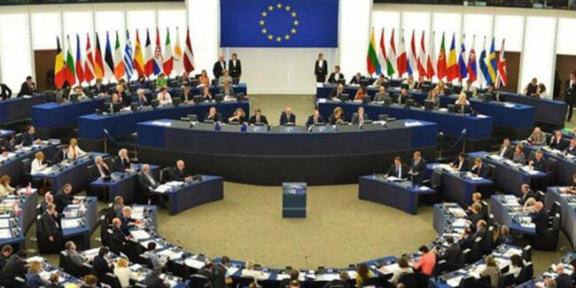
Negotiating Framework
Negotiating framework is based on Article 49 of the Treaty on European Union (Maastrict)
The shared objective of the negotiations is accession
Copenhagen criteria, absorption capacity of the EU will be taken into consideration
In case of serious and persistent breach in Turkey of the principles of liberty, democracy, respect for human rights and fundamental freedoms and the rule of law

Slide 5
EU-TR Financial Cooperation
Pre-Customs Union Period → 715 million Euro (1964-1995)
Customs Union Period → 612 million Euro (1996-1999)
Candidate Period → 1.320 million Euro (1999-2006)
IPA I Period → 4.795 million Euro (2007-2014)
IPA II Period → 4.453 million Euro (2014-2020)
Notes:
Peryodlar eklenecek

Slide 6
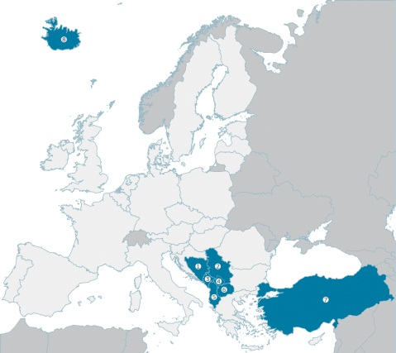

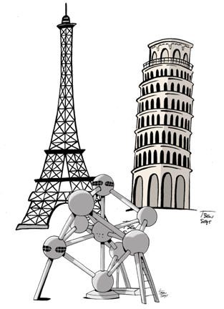









Methods of EU Budget Implementation
DIRECT
management
INDIRECT management
SHARED
management
European Commission
Executive Agencies
IPA II beneficiaries
International Organisations
International Financing Institutions
Member States
EU Delegations
Community
Agencies
Member State Agencies
Spec. Community bodies EIB, EIF

Slide 7
Instrument for Pre-accession (IPA)
The Instrument for Pre-Accession Assistance, or simply IPA, is a funding mechanism of the European Union. As of 2007, it replaced previous programmes such as the PHARE, ISPA, SAPARD and CARDS.
The Instrument for Pre-accession Assistance (IPA) is the means by which the EU supports reforms in the 'enlargement countries' with financial and technical help.
The EU pre-accession funds are a sound investment into the future of both the enlargement countries and the EU itself.

Slide 8
Instrument for Pre-accession (IPA II)
Allocations Per Country According to
Multi-annual Financial Framework 2014–2020*
In MILLION EUROS
ALBANIA
Bosnıa & Herz.
KOSOVO*
fYR of MACEDONIA
MONTENEGRO
SERBIA
TURKEY
1. Democracy &
governance
223.5
31
111.3
123
46.9
278
956.5
2. Rule of law &
fundamental rights
97
33
123
83
52.3
265
624.9
3. Environment &
climate action
68
/
/
113
37.5
160
644.6
4. Transport
56
/
/
113
32.1
175
442.8
5. Energy
/
/
100
/
/
125
93.5
6. Competitiveness
& innovation
44
63.8
133
73
21.2
105
345
7. Education, employment
& social policies
69
38
94.2
53
28.1
190
435
8. Agriculture &
rural development
92
/
79.7
106
52.4
210
912
9. Regional & territorial
cooperation
Multı-country
Multı-country
Multı-country
Multı-country
Multı-country
Multı-country
Multı-country
TOTAL
649.4
165.8
645.5
664
270.5
1508
4453.9
Per Person (EURO) | 225.89 | 47.27 | 352.53 | 320.15 | 434.55 | 214,69 | 55,80
Notes:
Per person bütçesi eklenecek

Slide 9
IPA II Legal Background
Financial Regulation
IPA II REGULATION
Regulations
COMMON IMPLEMENTING REGULATION
Implementing Financial Regulation
IPA II
IMPLEMENTING REGULATION
COUNTRY
STRATEGIES-INDICATIVE STRATEGY PAPER ( Based on Progress Reports)
ENLARGEMENT STRATEGY
Framework
Agreements
MULTI-COUNTRY STRATEGY
Planning & programming
SECTORAL PROGRAMMES
*
MULTI-COUNTRY PROGRAMMES
Financing
Agreements

Slide 10
The Indicative Strategy Paper for Turkey
sets out the priorities for EU financial assistance for the period 2014-20 to support Turkey on its path to accession.
It uses the political priorities set out in the enlargement policy framework to identify key areas where financial assistance is most needed and most useful in helping Turkey meet the accession criteria.

Slide 11
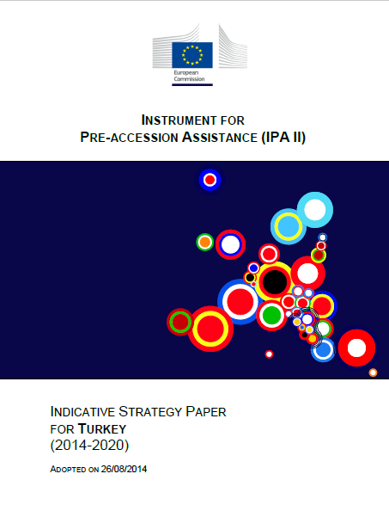
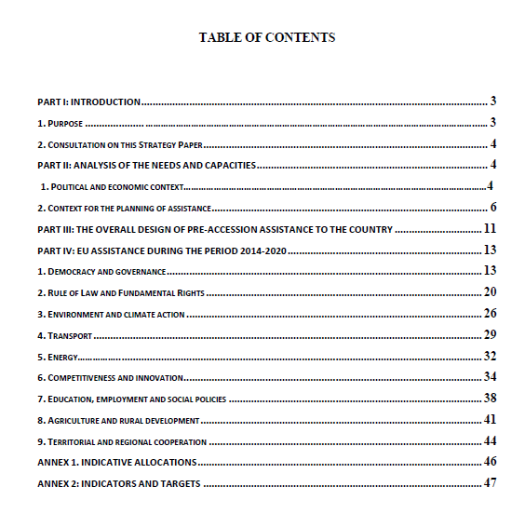
Strategy Paper

Slide 12
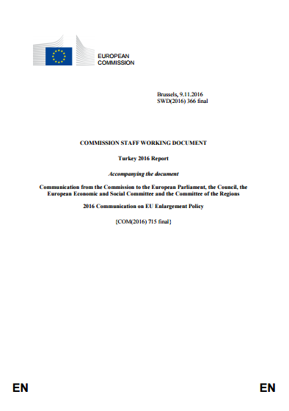
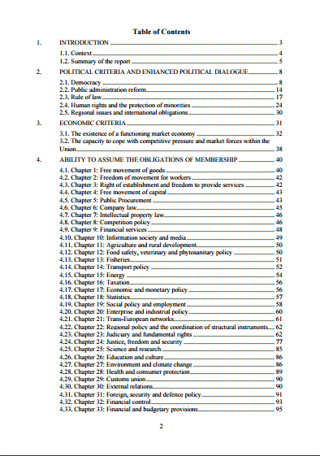
The Commission’s Annual Progress Reports*

Slide 13
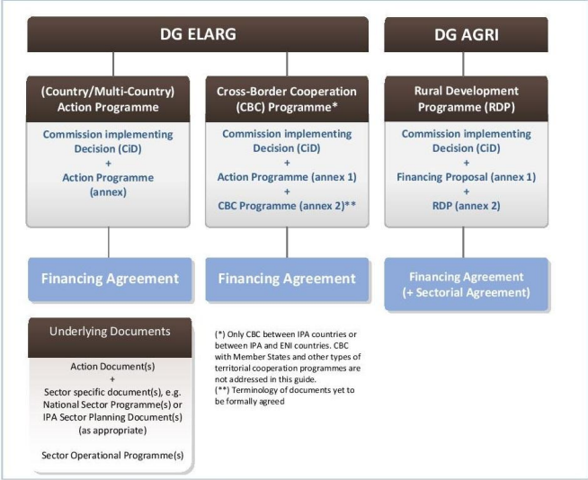
IPA Programme Types And Related Documents
NEAR

Slide 14
Strategy, Action Documents and Their Financing Decisions
Indicative Country Strategy Paper
Framework Agreement
Sectoral Opeational Programme (Multi-Annual Action Programme on Transport)
Financing Agreement
Projects
OIS or MPAF-BPA

Slide 15

Framework Agreement
Means an arrangement concluded between the Commission and an IPA II beneficiary applying to all IPA II policy areas and laying down the principles of the financial cooperation between the IPA II beneficiary and the Commission under this IPA IR Regulation (IPA IR Article 2 Definitions);

Slide 16
Financing Agreement
Means an annual or multi-annual agreement concluded between the Commission and an IPA II beneficiary, for implementing the Union's financial assistance through an action falling within the scope of IPA II IR

Slide 17
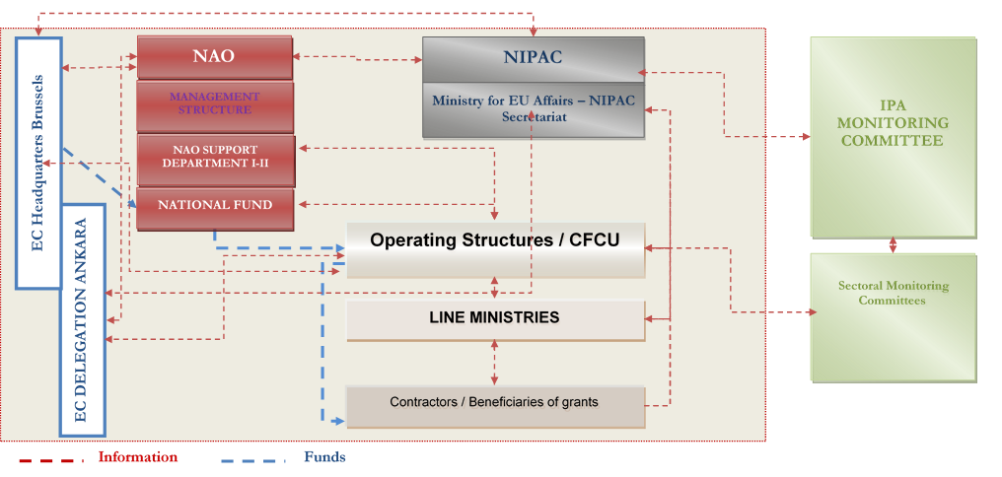
Overview of the IPA Institutional Structure in Turkey
2015/15 Prime Minister Circular
NAO-OS Agreement

Slide 18


