Slide 1
IPA II (2014-2020) Döneminde Ulaştırma Program Otoritesi ve Nihai Faydalanıcıların Güçlendirilmesi için Teknik Destek EuropeAid/139809/IH/SER/TR
Knowledge of EU Financial Aid Legislation
11.12.2020
1
Notes:
Başlık fontu Arial 28, yazı fontu ise Arial 24 olarak belirlenmiştir, lütfen devamlılığı ve uyumu sağlayabilmek adına başka bir yazı tipi ve boyutu kullanmayınız.
Lütfen ilgili bölümlere eğitimin adını ve tarihini ekleyiniz. Gerekli eklemeleri yaptıktan sonra slayt içindeki ve buradaki notları silebilirsiniz.
*LÜTFEN toplamda 25 slaytı GEÇMEYİNİZ.
1

Slide 2
Öz Değerlendirme Formunu doldurmak için:
10 Dakika
2

Slide 3
What is the Multiannual Financial Framework (MFF)?
is the overall EU budget for every seven-year period, setting out funding for the EU’s major programmes. The MFF is funded mostly by direct contributions from member states, although some pay in more than they receive from EU programmes and vice versa – these are known as net contributors and net recipients
respectively. The amount each member state contributes is largely based on the size of its economy, with larger members paying
more than smaller ones.
LINK !!!!!!
3

Slide 4
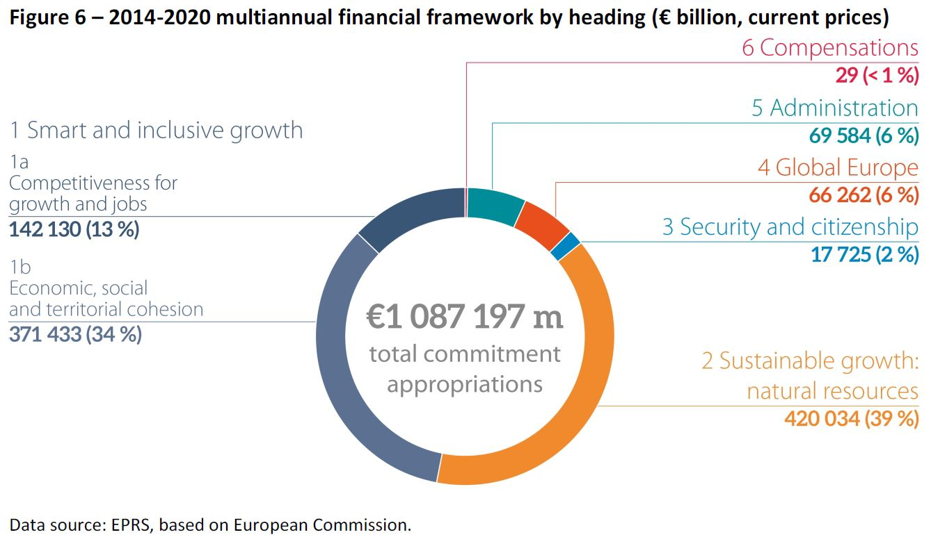
4

Slide 5
MFF – Legal Basis
Article 312 of the TFEU
MFF 2014-2020 Council Regulation
The Interinstitutional Agreement of 2 December 2013 between the European Parliament, the Council and the Commission on budgetary discipline, on cooperation in budgetary matters and on sound financial management.
MFF 2021-2027 Proposal
5

Slide 6
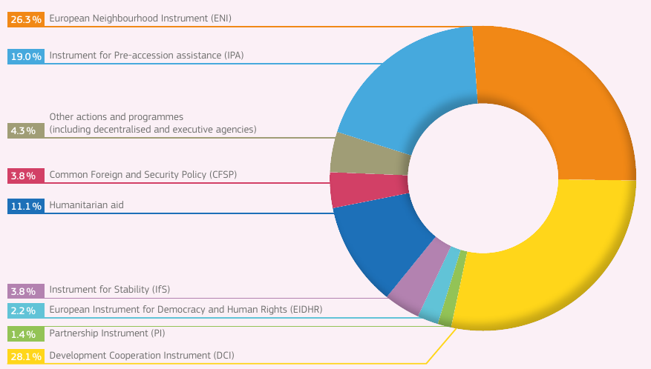
Heading 4: Global Europe
6

Slide 7
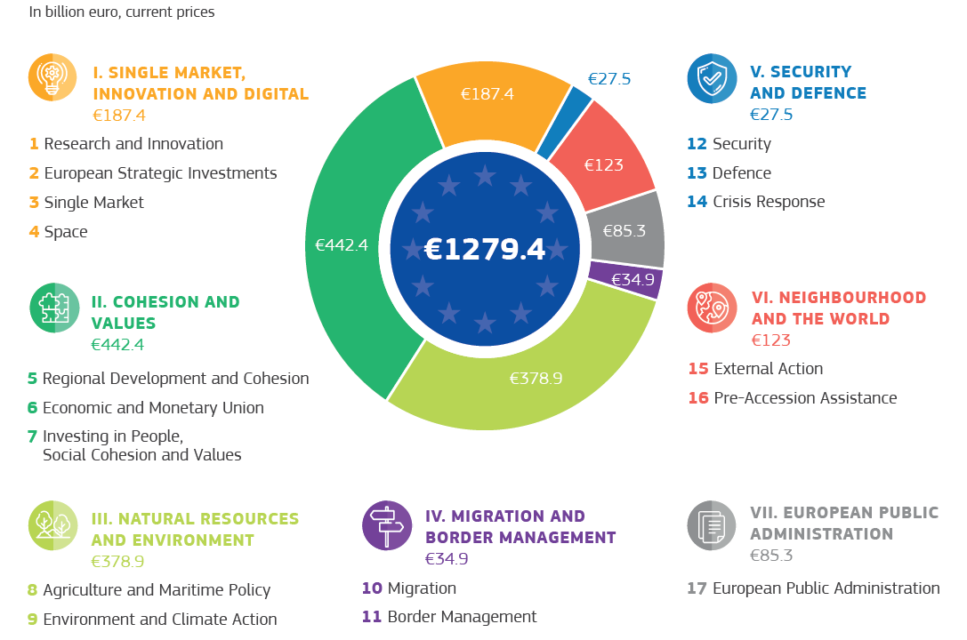
2021 – 2027 MFF
7

Slide 8
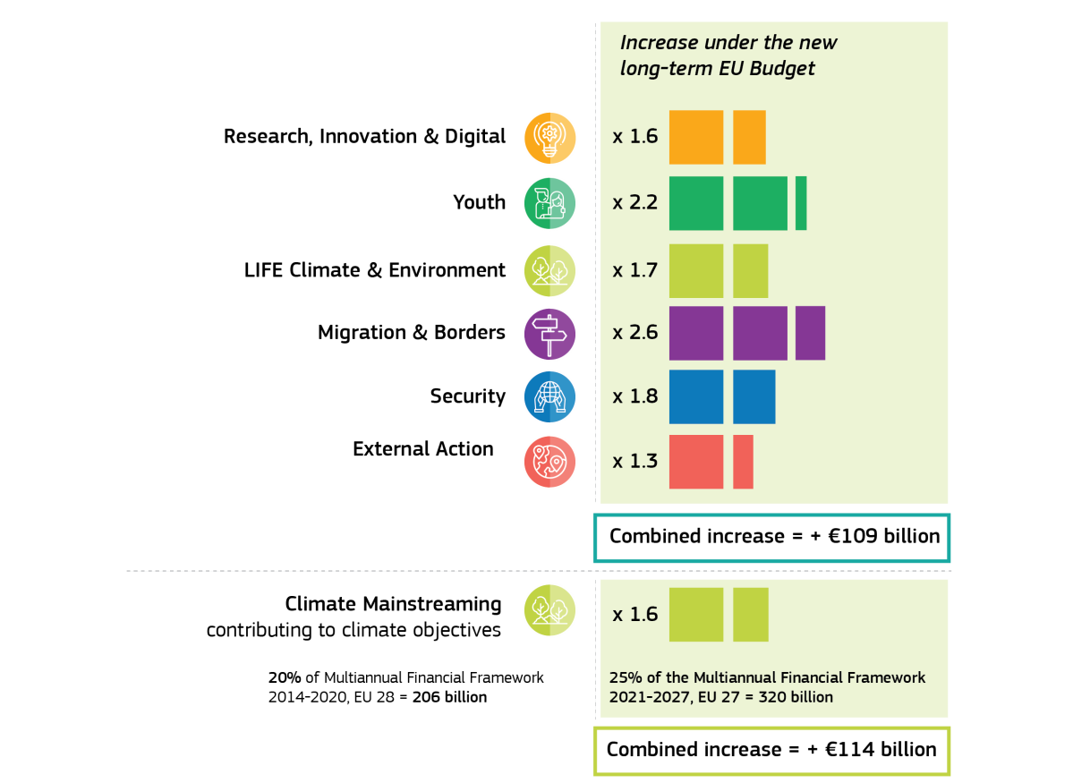
Strong Focus on European Added Value | Reinforcement of Priority Areas
Note: Compared to Multiannual Financial Framework 2014-2020 at EU-27, including European Development Fund
8

Slide 9
Heading
In current MFF
58
Existing Programmes
37
NEW Programmes
NEW Heading
Erasmus+
European Union Programme for Employment and Social Innovation (EaSI)
International Thermonuclear Experimental Reactor (ITER)
Connecting Europe Facility (CEF)
EFSI
EGNOS and Galileo
European statistical programme (ESP)
European Earth Observation Programme (Copernicus)
Financial reporting and auditing
Interoperability Solutions and common frameworks for European public administrations, businesses and citizens (ISA2)
Programme for the Competitiveness of Enterprises and small and medium-sized enterprises (COSME)
Action programme for customs in the European Union (Customs 2020)
Action programme for taxation in the European Union (Fiscalis 2020)
Anti-Fraud Information System (AFIS)
Euratom Research and Training Programme
Exchange, assistance and training programme for the protection of the euro against counterfeiting (Pericles 2020)
Nuclear decommissioning assistance programme in LT
Nuclear decommissioning assistance programmes in BG and SK
Programme to promote activities in the field of the protection of the financial interests of the European Union (Hercule III)
European Solidarity Corps
European Defence Fund
Enhancing consumers involvement in EU policy making in the field of financial services
Cohesion Fund
European Regional Development Fund
European Social Fund
YEI dedicated envelope (pm)
Fund for European Aid to the Most Deprived (FEAD)
Structural Reforms Support Programme (SRSP)
European Agricultural Fund for Rural Development (EAFRD)
European Agricultural Guarantee Fund (EAGF)
European Maritime and Fisheries Fund (EMFF)
Fisheries organisations and agreements
Programme for the Environment and Climate Action (LIFE)
Asylum, Migration and Integration Fund (AMIF)
Creative Europe
Justice Programme
Rights, Equality and Citizenship programme
Statement on Financial Intervention of the Communication Policy Area
Union action in the field of health (Health Programme)
Consumer Programme
Food&feed
Internal Security Fund (ISF)
IT systems (migration & security)
Instrument for Emergency Support within the Union
Union Civil Protection Mechanism
Guarantee Fund for External Actions
European Fund for Sustainable Development
Common foreign and security policy
Cooperation with Greenland
Development Cooperation Instrument
European Instrument for Democracy and Human Rights
European Neighbourhood Instrument
Financial support for Turkish-Cypriot community
Instrument contributing to Stability and Peace
Macro Financial Assistance
Partnership instrument for cooperation with third countries (PI)
Instrument for Pre-accession Assistance (IPA II)
EU Aid Volunteers initiative (EUAV)
Humanitarian aid (HUMA)
Instrument for Nuclear Safety Cooperation (INSC)
Administration
POLICY CLUSTERS
1. Research & Innovation
2. European Strategic Investments
3. Single Market
1A
4. Space
5. Regional Development & Cohesion
Horizon Europe International Thermonuclear Experimental Reactor (ITER) Euratom Research & Training Programme InvestEU Fund Connecting Europe Facility Digital Europe Programme (incl. Cybersecurity) Single Market Programme (incl. Competitiveness and Small and Medium-Sized Enterprises - COSME, Food Safety, Statistics, Competition and Administrative Cooperation) EU Anti-Fraud Programme Cooperation in the Field of Taxation (FISCALIS) Cooperation in the Field of Customs (CUSTOMS) European Space Programme European Regional Development Fund Cohesion Fund Support to the Turkish-Cypriot Community Reform Support Programme including the Reform Delivery Tool and Convergence Facility Protection of the Euro Against Counterfeiting European Social Fund + (incl. Integration of Migrants & Health) ERASMUS+ European Solidarity Corps Justice, Rights & Values Creative Europe (incl. MEDIA) European Agricultural Guarantee Fund European Agricultural Fund for Rural Development European Maritime & Fisheries Fund Programme for Environment & Climate Action (LIFE) Asylum & Migration Fund Integrated Border Management Fund Internal Security Fund Nuclear Decommissioning (Lithuania) Nuclear Safety and Decommissioning (incl. for Bulgaria and Slovakia) European Defence Fund Connecting Europe Facility - Military Mobility Union Civil Protection Mechanism Neighbourhood, Development and International Cooperation Instrument (incl. external aspects of migration) Humanitarian Aid Common Foreign & Security Policy Greenland, Overseas Countries & Territories Pre-Accession Assistance Administrative Expenditure, Pensions and European Schools
6. Economic & Monetary Union
7. Investing in People, Social Cohesion & Values
1B
8. Agriculture & Maritime Policy
2
9. Environment & Climate Action
10. Migration
3
11. Border Management
12. Security
13. Defence
4
14. Crisis Response
5
15. External Action*
special instruments
16. Pre-accession Assistance
17. Administration
Source: European Commission
9

Slide 10
Flexibility in Programming
Re-programming at mid-term
Blending of funds & transfers between management modes
Programme Reserves (unallocated envelopes) within each programme
Sound Financial Management and the Rule of Law
It will allow: to suspend, reduce or restrict access to EU funding
It will apply to: all EU funds implemented in shared management
It would not affect: the individual beneficiaries of EU funding
10

Slide 11
HEADING VI: Neighborhood and the world | Amounts (billion euro)
Neighbourhood, Development and International Cooperation Instrument | 89.2
Instrument for Pre-accession assistance | 14.5
Humanitarian aid | 11
Common Foreign and Security Policy | 3
Overseas countries and territories including Greenland | 0.5
European Instrument for Nuclear Safety | 0.3
Other | 1.219
Margin | 3.283
Total | 123.002
European Peace Facility | 10.5
11

Slide 12
12

Slide 13
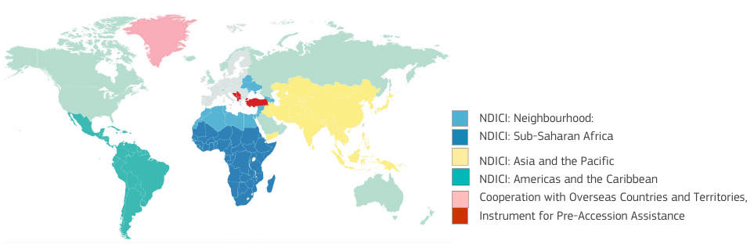
The Geographic Pillar of NDICI:
13

Slide 14
Principles guiding EU budget
Subsidiarity The level of governance (and thus also the financing) should be taken at the level of governance that is most effective.
Proportionality The content and form of the action must be in keeping with the aim pursued.
*Article 5 - TEU
14

Slide 15
Financing Methods - 1
Regulation 236/2014 common rules and procedures for the iplementation of Union’s instruments for financing extenal action:
Grants
Procurement contracts for services, supplies or works
General or sector budget support
Contributions to trust funds
Financial instruments such as loans, guaranties, equity or quasi-equity, investments or participations, and risk-sharing instruments
Actions financed under instruments may be implemented by means of parallel or joint co-financing
15

Slide 16
Financing Methods - 2
Donor coordination Coordination with other donors and international financial institutions (IFIs) - is key to boost aid effectiveness and foster capacity building
The Western Balkans Investment Framework
to pool grants, loans and expertise together to prepare financing for a common pipeline of priority investment projects
to strengthen coherence and synergies in donors' support to improve the positive impact and visibility of these priority investments in the beneficiary countries of the region
16

Slide 17
General Principles - 1
Additionalty Contributions from the Funds must not replace public or equivalent structural expenditure by a Member State in the regions concerned
Parnership (Euroepan Code of Conduct on Partnership) Each programme is developed through a collective process involving authorities at European, regional and local level, social partners and organisations from civil society
Ownership Donors should rely on the national development strategies and priorities of the recipient countries in the formulation and implementation of their development aid programs
17

Slide 18
General Principles - 2
Fundamentals first Links the rule of law and fundamental rights with economic governance and reforms and the strengthening of democratic institutions and public administration reforms
Co-financing The EU funding is not to replace the minimum co-financing from the beneficiary (own public or private funds)
No double financing No costs for the same activity be funded twice from the EU budget
No-profit The action covered by a grant may not generate profits
18

Slide 19
Important Provsion: Sate Aid
Article 107(1) TFEU European Union rules on State aid were put in place to ensure that state-owned resources are not deployed to distort competition or create unfair advantage in the European single market.
State aid rules for financial instruments is recalled in title IV of the Common Provisions Regulation ('CPR'), notably in its Articles 6, 37, 38, 42 and 44
19

Slide 20
IPA Legislation – Legal basis
Article 212(2) of the TFEU
IPA II Regulation
IPA II Implementing Regulation
Common Implementing Regulation (CIR)
Presidential Circular No:2019/20 of 4 October 2019
IPA III Regulation - Proposal
20

Slide 21
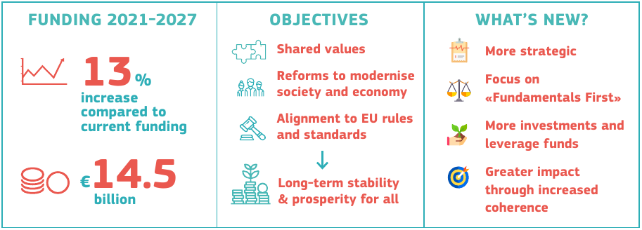
IPA III Legislation – Comission Proposal - 1
21

Slide 22
IPA III Legislation – Comission Proposal - 2
More strategic
Renewed focus on key reforms for Union membership
Increased reliance on country-led strategies resulting in greater ownership
Programming based on key priorities, rewarding performance and progress
Focus on ‘fundamentals first’
Primary focus on rule of law and respect of fundamental values
Strengthening democratic institutions and public administration reform
Promoting economic governance and reforms towards competitiveness
22

Slide 23
IPA III Legislation – Comission Proposal - 3
More investments and levrage of funds
Mobilising strategic investments in connectivity of infrastructure, SMEs, energy efficiency, innovation and digital economy. Increased reliance on country-led strategies resulting in greater ownership
Crowding in private investments via the External Action Guarantee which will have the capacity to guarantee investments up to €60 billion worldwide including in IPA beneficiaries
23

Slide 24
IPA III Legislation – Comission Proposal - 4
Greater impact through increased coherence
Coherence and complementarity between the Instrument for Pre-Accession Assistance and the new Neighbourhood, Development and International Cooperation Instrument. The thematic and rapid reaction components of this new cooperation Instrument will also benefit candidate countries and potential candidates
More synergies with a wide range of EU internal policy programmes to maximise impact on key priority sectors such as security, migration, research and innovation, environment and climate action, transport and energy connectivity
24

Slide 25
IPA III Proposal
The beneficiaries shall be eligible to the European Fund for Sustainable Development Plus (EFSD+) and to External Action Guarantee.
Assistance under IPA III may be provided to the type of actions provided for under the European Regional Development Fund and the Cohesion Fund, the European Social Fund Plus and the European Agricultural Fund for Rural Development.
IPA III shall contribute to actions established under Regulation [(Erasmus28]. [Regulation (EU) Erasmus] shall apply to the use of those funds.
25

Slide 26
Eğitim Sonrası Değerlendirme Anketini doldurmak için:
10 Dakika
26

Slide 27
Teşekkürler!
Tüm sorularınızı ve yorumlarınızı bekleriz.
27

