Slide 1
BASIC PRAG TRAINING
PROCUREMENT UNIT
May 2019
Trainer
Bengi SARISALTIKOĞLU

Slide 2
AGENDA
  LEGAL FRAMEWORK
  MANAGEMENT MODES
  BASIC PROCUREMENT PRINCIPLES
  TYPES OF CONTRACT
  PROCUREMENT PROCEDURES
  PROCUREMENT PLANNING (TIME-SCHEDULE)
  PUBLICATION OF TENDERS
  PREPARATION OF TENDER DOCUMENTS (WORKS- SERVICES– SUPPLIES)
  OPENING of TENDERS
  KEY ISSUES
  TENDER EVALUATION AND CONTRACT AWARD

Slide 3
TRAINING OBJECTIVES
To provide basic appreciation of:
  basic PRAG procurement rules
  the various modes of procurement management
  which contract type to apply
  which procurement procedure to apply
  time planning of procurement procedures
  publication of tenders
  basic structure of tender dossiers
  principles of tender evaluation and contract award

Slide 4
  WHAT IS “PRAG” ?
  “the Practical Guide to Contract Procedures for EU External Actions”
  Latest update published in August 2018
  Consists of:
  the Guide itself
  separate Annexes (templates) for procurement of Works / Services / Supplies / Grants

Slide 5
  PRAG – LEGAL FRAMEWORK
  PRAG defines the contracting procedures applying to all EU external aid contracts financed from the EU general budget (Budget) and the 11th European Development Fund (EDF)
  PRAG incorporates all legal requirements of EU Financial Regulations and relevant basic acts.
  PRAG incorporates the relevant provisions of the legal texts ruling the Budget
  PRAG provides all users with all the information necessary to manage procurement from the very first steps to the award of contracts.
  PRAG defines the procedures to be used for all “Management Modes”

Slide 6
  MANAGEMENT MODES
  There are three different management modes:
  direct management,
  indirect management,
  shared management.
  The choice of management mode is an essential element of the financing decision and it is reflected in the corresponding documents.
Notes:
There are different ways to implement the general budget of the EU or the European Development Fund (EDF) funds, depending on the degree of delegation of a number of budget implementation tasks (such as conclusion of contracts, their operational and financial management, audit, evaluation, etc.).

Slide 7
  DIRECT MANAGEMENT
Indirect management: the European Commission (or the EU executive agencies) is the contracting authority and takes decisions on behalf and for the account of the partner countries.
  INDIRECT MANAGEMENT
Under indirect management the European Commission entrusts budget implementation to:
  - third countries
  - international organizations
  - bodies set up under the Treaty on the Functioning of the European Union and the Euratom Treaty;
  - development agencies of EU Member States, or of third countries;
  - public law bodies, including Member States organizations.
Notes:
The contracts are concluded directly by the European Commission, acting on behalf of the partner country. The European Commission is responsible for the entire cycle leading to contract signature (issuing calls for tenders and calls for proposals, publication, establishing shortlist in restricted procedures, evaluation, award and contract signature, etc.).

Slide 8
INDIRECT MANAGEMENT WITH EX ANTE CONTROLS
Decisions are taken by the partner country, acting as contracting authority, in line with the requirements set out in this practical guide and subject to the prior approval of the European Commission. The contracts are signed by the contracting authority of the partner country and endorsed by the European Commission.
INDIRECT MANAGEMENT WITH EX POST CONTROLS
Subject to the positive outcome of a prior ex ante pillar assessment the European Commission may decide to rely on the rules and procedures of the third country entities' and to limit its control to ex post controls.
Notes:
Prior to the launch of the procurement procedure or call for proposals, the contracting authority must submit the documents (prior information notice, contract notice, tender dossier or call for proposals file) to the European Commission for approval. The European Commission verifies that these have been drafted in accordance with the procedures and templates laid down in this practical guide. The contracting authority is then responsible for drawing up shortlists (for restricted procedures), issuing the calls for tenders and calls for proposals, receiving applications, tenders and proposals, chairing evaluation committees and deciding on the results of the procedure. Before signing contracts, the contracting authority submits the results of the evaluations to the European Commission for prior approval.
No prior approval is required in certain cases referred to in the practical guide to procedures for programme estimates. The relevant steps leading to contract award need the prior approval of the European Commission.

Slide 9
SHARED MANAGEMENT
This mode is rarely used in the implementation of external actions, but there are a few cases such as joint operational programmes on cross-border cooperation implemented by a joint managing authority (for instance under the European Neighborhood Instrument (ENI) or the Instrument for Pre-accession Assistance (IPA II).

Slide 10
  PARTIES INVOLVED
  EUD ( Ex-ante approval & Observer)
  CA (Contracting Authority & Employer & Final Beneficiary)
  Ministries (Operational Structures) – some are CAs
  End Recepient(s)
  Contractor(s)

Slide 11
  GENERAL RESPONSIBILITIES OF THE CONTRACTING AUTHORITY
submit procurement notices and award notices to the EUD for publication (except PIN)
submit tender dossiers to the EUD for approval
Following approval, the CA is responsible for issuing invitations to tender, receiving tenders, chairing tender Evaluation Committees
The CA submits the Tender Evaluation Report to the EUD for approval of the award decision
The CA issues the Award Notification to the successful tenderer
Following receipt and approval of the required proofs, the CA issues the Contract Award proposal to the EUD for endorsement
Following the EUD’s endorsement, the CA signs and awards the Contract

Slide 12
  BASIC PROCUREMENT PRINCIPLES
Requesting information only once
As provided for by Article 128 FR, information already available at European Union institutions, the management authorities and other bodies and entities implementing the European Union budget, must be used to the extent possible to avoid asking persons and entities receiving European Union funds for the same information more than once.
Non-retroactivity
Contracts take effect from the date of signature of the last signatory. All contracts must show the true dates on which the contracting parties signed them.
Awarding principles
All contract awards must respect the principles of transparency, proportionality, equal treatment and non-discrimination

Slide 13
RECORD KEEPING
Unsuccessful proposals have to be kept for 3 years from the submission deadline of the call
unsuccessful tenders have to be kept for 5 years from the submission deadline of the tender.
Contractual and financial documents have to be kept for a minimum of 7 years from payment of the balance and up to the prescription date of any dispute about the law governing the contract. During and after this period, the contracting authority will treat personal data in conformity with its privacy policy.
Financial guarantees (originals) must be kept in a safe place where they are protected against the risk of loss or theft up to the end of their validity period or the end of the contractual obligations.
Notes:
Subject to the contracting authority's legislation on access to documents, written records of the entire procurement and grant award procedure must be kept confidential and kept by the contracting authority in accordance with the policy adopted on archiving. If its law conflicts with the confidentiality required, the contracting authority must obtain prior authorisation from the European Commission before disclosing any information.

Slide 14
  TYPES OF CONTRACT
  WORKS CONTRACTS
  The outcome of building or civil engineering works that fulfil an economic or technical function. Works contracts cover either the execution, or both the execution and design, of works.
  SERVICES CONTRACTS
  The provision of external know-how, studies or technical assistance, provision of services to supervise the construction of a works contract to support EU cooperation policy.
  SUPPLIES CONTRACTS
  Covers the purchase, leasing, rental or hire purchase of products
  May also include incidental “works” for installation of the supplies and “services” for training etc.
Notes:
Study contracts - includes studies for the identification and preparation of projects, feasibility studies, economic and market studies, technical studies and audits.
Technical assistance contracts – is a service contract where the contractor is called on to play an advisory role, to manage or supervise a project, or to provide the expertise specified in the contract (capacity building, advice on the management of a project )

Slide 15
TYPES OF SERVICE CONTRACT
Global Price
A lump sum contract where specified output(s) is/are set out, in the form of clearly defined deliverables like a report or drawings.
Fee-based
Where the output is unpredictable or specified output is impossible to quantify in advance, fee-based contracts are more appropriate, as it is economically more advantageous to pay the services on the basis of time actually worked. Fee-based contracts may also include activities paid on the basis of lump sums.
Notes:
Examples of global price activities: Studies, evaluations, audits, organization of events such as conferences, training sessions. Studies include a variety of tasks like identification and preparation of projects, feasibility studies, economic and market studies, technical studies, drafting a legal document, evaluations and audits.
An example could be a fee-based contract for training, where the trainings would be paid on a fee-based basis, and where the development of the training material would be paid on a lump sum basis.

Slide 16
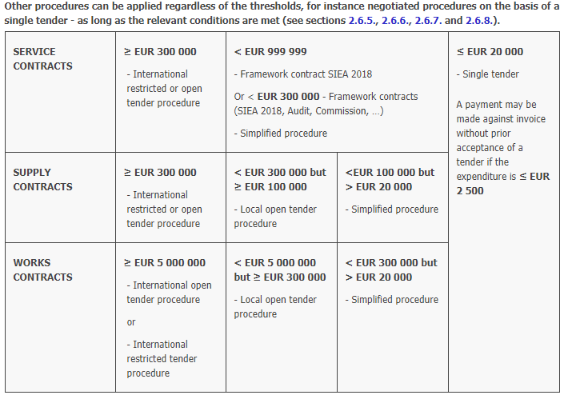
Which procurement procedure to apply?

Slide 17
  PROCUREMENT PROCEDURES
  “INTERNATIONAL OPEN” – Works > €5,000,000 and Supplies > €300,000
  The tender is given maximum publicity by publication of a Procurement Notice in the Official Journal of the European Union, the EuropeAid website and any other appropriate media.
  All interested economic operators may submit a tender.
  Any natural or legal person wishing to participate may request the tender dossier (possible payment required).
  Submitted tenders are examined and evaluated in accordance with the selection criteria specified in the Procurement Notice and Tender Documents.
  No negotiation is allowed

Slide 18
  PROCUREMENT PROCEDURES
  “RESTRICTED PROCEDURE” – Services > €300,000 (exceptionally – Prequalification for Works tenders)
Two stages:
STAGE 1 – SHORT-LISTING OF APPLICANTS
  The tender is given maximum publicity by publication of a Contract Notice in the Official Journal of the European Union, the EuropeAid website and any other appropriate media.
  The Contract Notice must define clear and unambiguous financial and technical selection criteria.
  Evaluation Committee establishes a “short-list” of qualified applicants (minimum 4 – maximum 8).
  List of shortlisted applicants published on the Europe Aid website.

Slide 19
  PROCUREMENT PROCEDURES
  “RESTRICTED PROCEDURE” – Services > €300,000 (exceptionally – Prequalification for Works tenders)
  STAGE 2 – TENDER
  Tender dossier issued to Short-listed applicants.
  Tenders must be submitted by the same service provider or consortium which was short-listed.
  Submitted tenders are evaluated in accordance with the criteria identified in the Tender Dossier

Slide 20
  PROCUREMENT PROCEDURES
  “LOCAL OPEN PROCEDURE” – Works (€300,000 to €5,000,000) and Supplies (€100,000 to €300,000)
  the tender is given local publicity by publication of a Contract Notice in the Official Journal of Beneficiary country and the EuropeAid website.
  same as for International Open Tenders
Notes:
International eligible contractors must be given the same opportunities as local firms, there must be no restrictive conditions e.g. obliging firms to be registered in the beneficiary country or to have won contracts there in the past.
other procedures are substantially the

Slide 21
  PROCUREMENT PROCEDURES
  “SIMPLIFIED PROCEDURE”
  Works (€20,000 to €300,000), Supplies (€20,000 to €100,000), Services (to €300,000)
  No publicity is required.
  The Contracting Authority draws up a list of at least three contractors / suppliers / consultants.
  Candidates are sent a letter of invitation to tender and the tender dossier, including selection and award criteria.
  A minimum of one qualifying offer is required.
  If the procedure fails following two successive attempts, the CA may conclude a contract by negotiation (subject to prior EC approval).
  Other procedures are as per International and Local Open procurement.
  Under the simplified procedure, the contracting authority invites at least three candidates of its choice to submit tenders.
  The evaluation (including the use of an evaluation committee) and the award of the contract follow the rules of the open procedure.

Slide 22
SINGLE TENDER (up-to EUR 20.000)
The tenders of 2.500 € and less can be awarded on the basis on an invoice, without prior acceptance.
For the tenders higher than 2.500 and up-to 20.000 € a single tender procedure must apply with providing a format of negotiation report. There are two possible scenarios to be applied with:
1. If one tenderer invited:
The tender should be carried out under the template for Negotiation report for single tenders, annex A10b.
The assessment procedure serves only for confirming the administrative and technical compliance of the tender to the requirements, set out in the Instruction to tenderers. Eligibility rules and selection criteria must be duly complied with. Documentary evidence for exclusion criteria and selection criteria should be submitted.
Notes:
Based on the complexity, amount and the nature of the tender, the Beneficiary may choose to invite ONLY ONE TENDERER under a Single Tender Procedure.

Slide 23
2. If more tenderers invited:
The respective PRAG tender dossier for Competitive negotiated procedure simplified tender dossier – b8o is to be used. The Contracting Authority has to evaluate all tenders according to the “best value for money” award criterion, by establishing best price-quality ratio, and weighing technical quality against price on an 80/20 basis.
This evaluation must also be documented in the Negotiation Report for single tenders, annex A10b.

Slide 24
  PROCUREMENT PLANNING
  SEQUENCE and TIMING
Procurement procedures usually take longer than planned.
Minimum periods defined in PRAG must be respected.
No short-cuts permitted.
Build-in “safety margins” to cover the following:
Possibility of having to issue corrigendum to Tender Dossiers.
Long evaluation due to excessive requests for clarification.
Holiday periods (summer / religious holidays etc.)
Delays in Ex-ante control.
The time schedules should be regarded as an absolute minimum

Slide 25
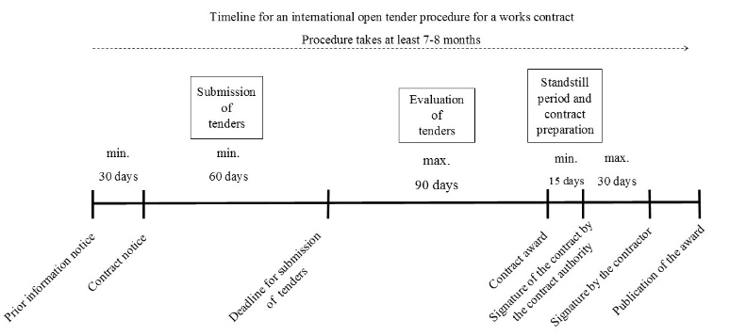
  PROCUREMENT PLANNING SEQUENCE and TIMING
  (Works Contract with a value of EUR 5 000 000 or more)

Slide 26
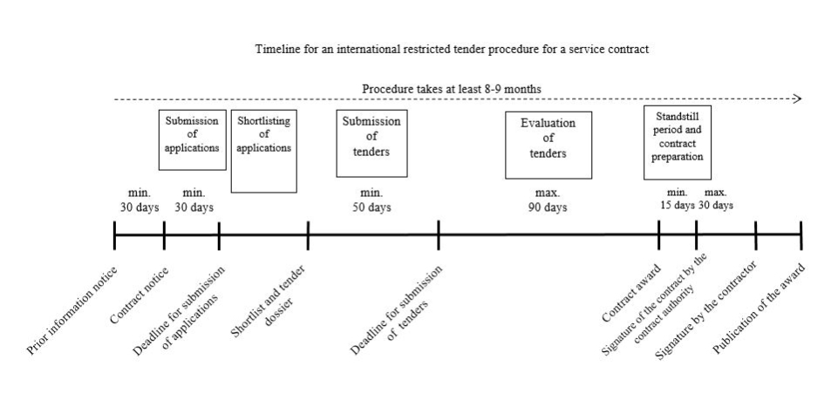
  PROCUREMENT PLANNING SEQUENCE and TIMING
  (Service Contract with a value of EUR 300 000 or more)

Slide 27
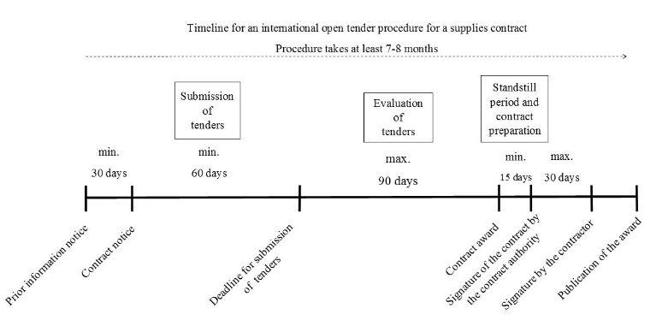
  PROCUREMENT PLANNING SEQUENCE and TIMING
  (Supply Contract with a value of EUR 300 000 or more)

Slide 28
WORKS CONTRACT PRIOR INFORMATION NOTICE
Construction of Çerkezköy - Kapıkule Section of
Halkalı - Kapıkule Railway Line
Location - Turkey
1.
Publication reference
EuropeAid/139362/IH/WKS/TR
Procedure
Open
2.
3.
Programme title
Multi-annual country Action Programme for Turkey on Transport
2014/031-877
4.
Financing
IPA budget item 22.02 03 02 of the General Budget of the EU and National Contribution.
5.
Contracting Authority
Ministry of Transport, Maritime Affairs and Communications, Directorate General for Foreign
Relations and European Union Affairs, Department for European Union Investments, Ankara, Republic of Turkey
6.
Description of the contract
The contract will cover the construction of a new railway line consists of double track line with a maximum operational speed of 200 Km/h complete with telecommunication, signaling and electrification systems between Çerkezköy and Kapıkule Section of Halkalı - Kapıkule Railway Line Project. The existing electrified single line will be realigned at the stations of Çerkezköy and Edirne in order to connect to the new line.
7.
Indicative number and titles of lots
One lot only
8.
Scheduled publication date of the contract notice
1st quarter of 2018
Other information
9.
N/A
15 January 2016
d1_priorinfo_en.doc
Page 1 of 2

Slide 29
10. Legal basis¹
Regulation (EU) N°236/2014 of the European Parliament and of the Council of 11 March 2014 laying down common rules and procedures for the implementation of the Union's instruments for financing external action and Regulation (EU) No 231/2014 of the European Parliament and of the Council of 11 March 2014 establishing an Instrument for Pre-accession Assistance (IPA II) (OJ L 77, p.11-26).
The conclusion of the tender and the award of any contract is subject to the availability of funds
and the adoption by the European Commission of the relevant financing decision.
The contracting authority reserves the right to cancel the tendering procedure at any time.
Notes:
There must be an interval of at least 30 calendar days between the publication of this prior information notice and the publication of the corresponding contract notice. No applications or requests for further information should be sent at this stage.
¹ Please state any specificity that might have an impact on rules on participation (such as geographic or thematic or long/short term).
15 January 2016
d1_priorinfo_en.doc
Page 2 of 2

Slide 30
  PROCUREMENT PUBLICATION
  CONTRACT NOTICE
  Required for all Procedures (except simplified / FWC / single tender)
  Provides detailed information for interested parties to submit a tender
  Minimum period of 30 days from publication of ontract Forecast
  Main information to be included
  Type of Procedure (Open / Restricted)
  Programme (IPA)
  Financing
  Contracting Authority (CFCU)
  Description of Contract (Maximum 10 lines)

Slide 31
  BASIC PROCUREMENT PRINCIPLES
  Applicable to all procurement procedures
  ELIGIBILITY CRITERIA
  The Rule of Nationality
Participation is open on equal terms to all natural persons who are nationals of and legal persons established in:
a Member State of the European Union
a Member State of the European Economic Area; (EU Member States plus Iceland, Liechtenstein and Norway)
an official candidate country or potential candidate that is a beneficiary of the Instrument for Pre-Accession Assistance
a country that is directly beneficiary of the aid implemented through the corresponding basic act
  For the purposes of verifying compliance with the nationality rule, the tender dossier requires tenderers to state the country of which they are nationals or they are established by presenting the documents required under that country's law.
  Experts: unless otherwise foreseen in the basic act and/or the Financing Agreements, experts engaged by eligible tenderers may be of any nationality.

Slide 32
  BASIC PROCUREMENT PRINCIPLES
  ELIGIBILITY CRITERIA (continued)
  RULES OF ORIGIN
All goods (supplies and materials) purchased under a contract financed under an EU instrument must originate from the EU or from eligible country
The term “origin” is defined in the relevant EU legislation on rules of origin for custom purposes.
Where there is only one country of production, the origin of the finished product is easily established.
In cases where more than one country is involved in the production of goods, the country of origin is regarded as the country in which the goods have undergone their last economically justified substantial transformation.

Slide 33
  BASIC PROCUREMENT PRINCIPLES
  ELIGIBILITY CRITERIA (continued)
  RULES OF ORIGIN (continued)
Rules of origin do not apply to;
Equipment used by a works contractor for executing the works
Machinery used for testing and installing the supplied goods
Proof of origin
In cases where the provision of a Certificate of Origin is not possible (before presenting the commercial invoice), the tenderer can submit its own declaration
Original Certificates of Origin must be submitted before provisional acceptance

Slide 34
  BASIC PROCUREMENT PRINCIPLES
  ELIGIBILITY CRITERIA (continued)
GROUNDS FOR EXCLUSION
Tenderers or applicants will be excluded from participation in procurement procedures if:
they are bankrupt or being wound up
they have been convicted of an offence concerning their professional conduct by a judgement against which no appeal is possible
they have been guilty of serious professional misconduct proven by any means which the Contracting Authority can justify
they have not fulfilled obligations relating to the payment of social security contributions or the payment of taxes
they have been the subject of a judgement (against which no appeal is possible) for fraud, corruption, involvement in a criminal organisation or any other illegal activity detrimental to the EU's financial interests
Candidates, tenderers and applicants must sign a declaration that they do not fall into any of the above categories

Slide 35
  BASIC PROCUREMENT PRINCIPLES
  Applicable to all procurement procedures
  ELIGIBILITY CRITERIA (continued)
ADMINISTRATIVE & FINANCIAL PENALTIES
If any candidates, tenderers, applicants and contractors have made false declarations, or have made substantial errors or committed irregularities and fraud, then:
they may be excluded from all contracts and grants financed by the EU for a maximum of five years
the period may be extended to 10 years in the event of a repeated offence within five years.
they may also be subject to financial penalties representing 2% to 10% of the total estimated contract value

Slide 36
  PROCUREMENT PUBLICATION
  CONTRACT NOTICE (continued)
  Eligibility and rules of origin
  Number of Tenders (tenderers may only submit ONE tender)
  Tender Guarantee (1% - 2% of contract budget – optional for Local Open procedure)
  Performance Guarantee required from successful tenderer (normally 10%)
  Tender validity (90 days after tender submission deadline)
  Selection Criteria (same as defined in Instructions to Tenderers)
  Award Criteria (normally “Price”)
  Details of how to obtain Tender Dossier
  Tender submission deadline
  Language of procedure

Slide 37
  TENDER DOCUMENTS - WORKS
  A works tender dossier consists of 5 Volumes
  Volume 1
  Section 1: letter of invitation to tenderers
  instructions to tenderers
  Section 2: tender form
  Section 3: tender guarrantee
  Section 4: technical offer questionnaire
  technical offer form
  bank account notification form
  legal entity file
  Section 5: aministrative compliance grid
  evaluation grid

Slide 38
  Volume 2
  draft contract ( general conditions, special conditions)
  pre-financing guarantee
  performance guarantee
  retention guarantee
  tax and customs arrangements
  Volume 3
  technical specifications
  Volume 4
  financial interpretative note
  financial offer lump sum contracts
  financial offer unit price contracts
  Volume 5
  design drawings
  tender opening checklist, tender opening report, evaluation report, …

Slide 39
  TENDER DOCUMENTS - WORKS
  FIDIC Red or Yellow Book ??
  RED BOOK (Building & Engineering Works designed by Employer)
  YELLOW BOOK (Plant & Design-Build - for electrical and mechanical and for building and engineering works designed by the contractor)
 | RED BOOK | YELLOW BOOK
Design of the Works | Well defined – designed by the Employer | Designed by the Contractor based on Employer’s Requirements
Time schedule | Longer design period Shorter tender submission period | Shorter design period (concept only) Longer tender submission period
Risks | Employer’s design risk – lower tender prices | Contractor’s design risk – higher tender prices
Disputes | Reduced potential | Increased potential due to unforeseeable obstructions

Slide 40
  TENDER DOCUMENTS - SERVICES
  Standart Tender Dossier
    Letter of invitation to tender
    Instructions to tenderers
    Draft contract: Special conditions
    Draft contract: General conditions (Annex I)
    Draft contract: Terms of reference Fee-based (Annex II)
    Draft contract: Terms of reference Global (Annex II)
    Draft contract: Organisation & methodology (Annex III)
    Draft contract: List and CVs of key experts (Annex IV)
  Draft contract: Budget
    Budget for a global-price contract
    Budget breakdown for a fee-based contract
  Draft contract: Forms and other relevant documents
    Bank account notification form,
    Financial guarantee template
    Legal entity file,
    Expenditure verification
    Administrative compliance grid,
    Evaluation grid
    Tender submission form

Slide 41
  TENDER DOCUMENTS - SUPPLIES
  Substantially the same as for WORKS, except
  Rules of Origin – Tenderer to submit statement that all supplies comply with rules of origin
  Definition of Lots
  Tenderers may submit offer for any or all Lots
  Discounts can be offered in case of being awarded more than one Lot
  Award Decision
  Financial comparison should take into account best overall price, including discounts

Slide 42
  TENDER DOCUMENTS - SUPPLIES
Letter of invitation to tender
Instructions to tenderers
Draft contract
Draft contract : special conditions – general conditions
Technical specifications (Annex II) & technical offer (Annex III)
Financial offer (Annex IV)
Performance guarantee (Annex V)
Pre-financing guarantee (Annex V)
Administrative compliance grid
Evaluation grid
Tender submission form
Tax and customs arrangements (Annex V)
Tender guarantee

Slide 43
TENDER DOCUMENTS – SUPPLIES (continued)
Bank account notification form
Legal entity file
Tender opening checklist
Tender opening report
Evaluation report
Notification letter to tenderers
Letter to unsuccessful tenderers
Contract award notice for international calls
Contract award notice for other procedures
Contractor assessment form
Provisional and final acceptance
Addendum to contract
Budget modification

Slide 44
  OPENING OF TENDERS
  Works and Supplies
  Tenders opened in public session
  Chairperson announces:
  Tenderers' names
  Tender prices
  Any discount offered
  Notifications of alteration and withdrawal
  Presence of the requisite tender guarantee (if required)
  Minutes of Tender Opening Meeting to be issued to all renderers
  Services
  Tenders opened in private session

Slide 45
  KEY ISSUES
  SELECTION CRITERIA
  Selection criteria must be defined in all Contract Notices
  They cannot be subsequently amended - unless a corrigendum is issued (delays)
  Criteria must be clear and non-discriminatory criteria
  Criteria should be designed to ensure that successful candidates have adequate financial, economic, technical and professional capacity to implement the requirements of the contract
  Economic and financial criteria should be limited to the previous 3 financial years
  Professional and technical criteria should be limited to:
  Service and supply contracts – projects completed in the past three years
  Works contracts - projects completed in the past five year

Slide 46
  SELECTION CRITERIA (continued)
  Criteria must be specific – unambiguous “PASS/FAIL”
  It must be possible to verify compliance with the criteria (documentary evidence)
  For Joint Ventures / Consortia
  Services and Supplies – criteria apply to the combined capacity of all Partners
  Works
  capacity may be split between Partners, but the Lead Partner should be capable of satisfying at least 50% (for example)
  A Joint Venture Agreement must be submitted committing all Partners to their respective contribution
  Documentary Evidence
Services – evidence to be provided with tender
Supplies – only the successful tenderer to provide evidence before Award of Contract
Works – in accordance with the specific Instructions to Tenderers

Slide 47
  KEY ISSUES
  CANCELLATION
  Before Contract signature, the CA may cancel the procurement procedure (Prior approval)
  Justifiable circumstances
no qualitatively or financially worthwhile or no valid response at all
fundamentally altered the economic or technical data of the project
exceptional circumstances or force majeure
all technically compliant tenders exceed the available financial resources
irregularities
the award is not in compliance with sound financial management
all tenderers must be notified in writing of the reasons for cancellation
cancellation notice must be published (standard format)
launch a new tender procedure;
or
open negotiations with one or more tenderers that participated in the original tender procedure and which complied with the selection criteria (the original terms of the contract cannot be altered
or not to award the contract

Slide 48
  KEY ISSUES
  ETHICS CLAUSE
Extract from PRAG – “Any attempt by a candidate, applicant or tenderer to obtain confidential information, enter into unlawful agreements with competitors or influence the committee or the Contracting Authority during the process of examining, clarifying, evaluating and comparing tenders and applications will lead to the rejection of its candidacy, proposal or tender.”
Specific issues
All tenderers must formally declare that they are not affected by any potential conflict of interest
Civil servants or other officials of the public administration of the beneficiary country must not be engaged as experts, unless the prior approval of the European Commission has been obtained.
a contractor and its staff or any other company with which the contractor is linked may not supply other services, carry out works or supply equipment for the project.
The contractor must at all time act impartially and as a faithful adviser in accordance with the code of conduct of its profession

Slide 49
  KEY ISSUES
  ETHICS CLAUSE
Specific issues (continued)
The contractor must at all time act impartially and as a faithful adviser in accordance with the code of conduct of its profession
For the duration of the contract, the contractor and its staff must respect human rights and undertake not to offend the political, cultural and religious norms of the beneficiary state
The contractor is must maintain professional secrecy for the entire duration of the contract and after its completion
Remedial action
The Commission reserves the right to suspend or cancel project financing if corrupt practices of any kind are discovered and if the Contracting Authority fails to take all appropriate measures to remedy the situation
Failure to comply with one or more of the ethics clauses may result in the exclusion of the tenderer or contractor from other EU contracts and in penalties. The individual or company/entity must be informed of the fact in writing
Where fraud, corruption or other irregularities concerning EU funds is suspected, the anti­fraud office of the European Commission (i.e. OLAF) should be duly informed.

Slide 50
  EVALUATION OF TENDERS
  Composition of Evaluation Committee
  Appointed by the Contracting Authority
  Chairperson (non-voting)
  Secretary (non-voting)
  Odd number of voting members (minimum of three for all procedures except for works tenders above €5,000,000 which requires a minimum of five)
  Possible authorised “observers” (non-voting)
  Voting members must have a reasonable command of the language of the tender
  Voting members must possess the technical and administrative capacities necessary to give an informed opinion on the tenders

Slide 51
  EVALUATION OF TENDERS
  Confidentiality & Impartiality
  All Committee members and observers to sign Declaration of Confidentiality & Impartiality
  Apart from the tender opening session (Works and Supplies), all meetings of the Evaluation Committee are held in private
  Tender documents not to leave the Committee meeting room
  No informal communication between Committee members and renderers or their representatives

Slide 52
  EVALUATION OF TENDERS
  First stage – Administrative compliance
  Ensure that all the documentation defined in the Instructions to Tenderers has been submitted
  Rules of origin / nationality have been respected
  Language of documents
  Documents correctly signed
  (if applicable) JV / Consortia Agreements submitted
  (if applicable) Subcontracting statement acceptable
  Only administratively compliant tenders should be considered for the second evaluation stage

Slide 53
  EVALUATION OF TENDERS
  Second stage – Financial / Technical compliance
  Determine whether tenderers satisfy the selection criteria defined in the Instructions to Tenderers
  Financial
  Annual turnover
  Audited Financial Statements
  (Works) access to credit lines
  Previous relevant experience in contracts of a similar size / nature
  Documentary evidence
  Key Experts
  Works – proposed key personnel satisfy minimum experience requirements

Slide 54
  EVALUATION OF TENDERS
  Second stage – Financial / Technical compliance (continued)
  Technical Compliance – Works and Supplies (“yes/no”)
  Compliance with technical specifications
  Ancillary services (if applicable)
  Nationality of sub-contractors
  Other technical requirements
  Technical Compliance – Services (points according to Evaluation Grid)
  Quality of Organisation and Methodology
  Key Experts (proven skills / general experience / specific experience)
  Only offers scoring more than 80% should proceed to the Financial Evaluation stage

Slide 55
  EVALUATION OF TENDERS
  Third stage – Financial Offers
  Works
  Mathematical correction of Bill of Quantities
  Query any apparent “weighting” or “loading” of rates
  Services
  Mathematical correction of Budget Breakdown (fee-based contracts)
  Total Contract Value is less than the Contract Budget
  Supplies
  Mathematical correction of Financial Offer
  (if applicable) spare parts and consumables have been included)

Slide 56
  EVALUATION OF TENDERS
  Requests for Clarification
  At any stage, the Committee may ask tenderers to clarify details of their tenders
  Requests should be issued in writing with a (reasonable) deadline for responses
  Tenderers are not allowed to introduce any alterations to the substance of their tenders
  Examples of clarification requests
  Minor documents in the wrong language
  Minor documents missing
  (Services) Full evidence regarding Key Experts CVs not included
  (Services) Further details of Key Experts’ specific experience
  (Works) inconsistent unit rates – breakdown required
  (Supplies) additional technical properties of offered equipment

Slide 57
  EVALUATION OF TENDERS
  Conclusion of Evaluation
  Each Committee member should prepare an independent Evaluation Grid
  The Committee should discuss any major discrepancies in assessment and adjust as necessary (guidance from the Chairperson)
  The Committee should reach a unanimous decision
  Evaluation Report
  (Report to be prepared in strict accordance with PRAG templates)
  Summary of clarification requests and responses (administrative issues)
  Reasons for rejecting any tender for administrative non-compliance
  Summary of clarification requests and responses (technical issues)
  Reasons for rejecting any tender for technical non-compliance
  Summary of compliant tenders and financial offers
  Recommendation of Contract Award

Slide 58
  CONTRACT AWARD PROCEDURE
  Following the ex-ante endorsement of the Evaluation Report:
  CA notifies successful tenderer of its intention to award the Contract
  Tenderer to provide necessary proofs defined in Instructions to Tenderers
  Proof documents examined and approved
  Prepare Contract Dossier
  Standard Explanatory Note
  All tender evaluation documents
  Three originals of proposed Contract
  EC Delegation endorses Contract Dossier and returns to CA
  Contract signed by CA and sent to successful tenderer
  Tenderer to sign and return within 30 days

Slide 59
  CONTRACT AWARD PROCEDURE
  SERVICES
  Basically the same as for Works & Supplies, except:
  Following the ex-ante endorsement of the Evaluation Report:
  The successful tenderer is informed of the CA´s intention to award the Contract
  The tenderer must then provide:
  The necessary documentary proofs, and
  Confirmation that Key Experts are available (if not, then the tenderer must propose equivalent alternatives)
  If the tenderer fails to satisfy the above requirements, then the Contract may be awarded to the second-best tenderer…. or the tender may be cancelled

Slide 60
  OTHER ISSUES
  VISIBILITY
All contractors for services, supplies, works or grant beneficiaries must take the necessary measures to ensure the visibility of the EU financing or co-financing
Visibility rules are defined on the EuropeAid website at:
The rules relate to:
written and visual identity of the EU (e.g. flag, key message, definitions)
requirements and guidelines on communication activities and tools (e.g. press releases, websites, publications, films)
the obligation to submit a communication plan for the approval of the Contracting Authority

Slide 61
  OTHER ISSUES
The term 'conflict of interest' is used with different meanings in different contexts. Four cases can be distinguished:
(1) conflict of interest for the contracting authority
(2) grave professional misconduct
(3) involvement in drafting tender specifications and distortion of competition
(4) professional conflicting interests.
ORIGIN OF GOODS
In principle, goods must originate from an eligible country.
Subject to derogation (granted on a case by case basis), all goods to be delivered under a supply contract fall under the rules of origin, as do materials, goods and components to be incorporated or to form part of the permanent works under a works contract.

Slide 62
THANK YOU

